Slide 1
Causal Fairness
Guided Dataset Reweighting using Neural Networks
Xuan Zhao, Klaus Broelemann, Salvatore Ruggieri, Gjergji Kasneci
Presentation by: Kevin Richard

Slide 2
Motivation
Fairness:
It refers to the concept of treating individuals or groups equitably, without discrimination or bias to make decisions that do not perpetuate or amplify biases that may exist in the data or in society.
Causal Fairness:
It refers to fairness of causal relations in a system or model. It tries to ensure that the consequences of decision and actions of attributes are fair, especially w.r.t sensitive or protected attributes..

Slide 3
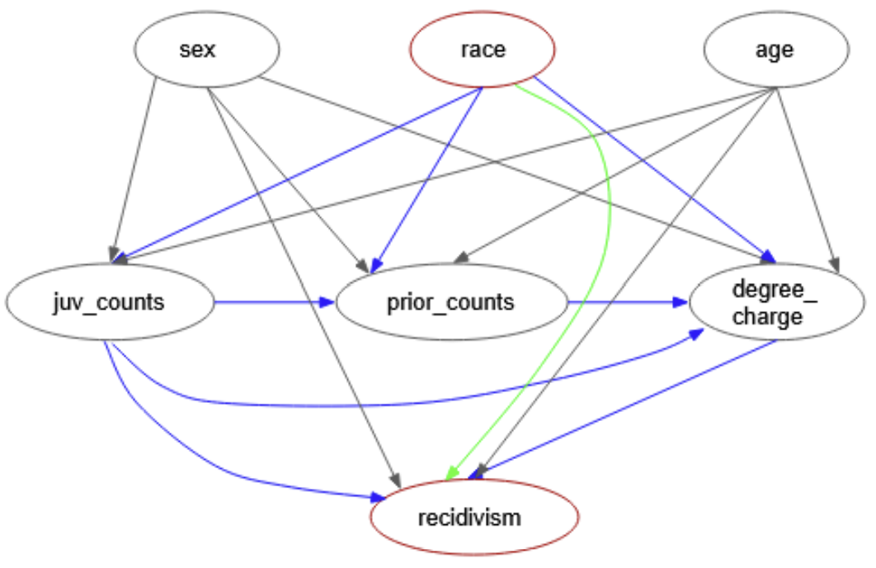
Understanding Causal Graph
Structure of Causal Model: (M)
M = (U, V, F )
Exogenous Variables: (U)
External variables that are not influences by others.
Endogenous Variables: (V)
Internal variables that are not influenced by others.
Deterministic Function: (F)
Measure of influence of U on V.

Slide 4


Causal Fairness Criteria
Total effect:
Causal effect of S on Y through all causal paths from S to Y.
Path-Specific Fairness:
Causal effect of S on Y through specific causal path from S to Y.
Counterfactual Fairness:
Similar to above but after creating duplicate data points and mixing up the sensitive attribute data.
Total Fairness:
Is satisfied when TE, SE, CE are above a certain fairness threshold value.
S -> Sensitive Attribute
Y -> Label
π -> Path subset
o -> Population subgroup

Slide 5
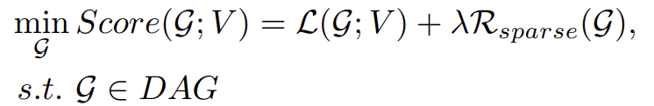
Causal Discovery: Extracting a causal graph from the given data.
Objective:
To find the best possible causal graph that explains the relationships between variables in a system based on observed data.
Score-Based Method:
Evaluate candidate graphs using a pre-defined score function. In the paper, they just assume that this is how they got their causal graph.
Constraint-Based Methods:
Uses conditional independence tests under specific assumptions to determine the Markov equivalence class of causal graphs.

Slide 6
Model : Controlled Neural Networks
A model similar to GAN called causalGAN which is trained adversarially.
Two generators are used to generate:
Simulate Causal Model
Interventional Model
Two Discriminators are used:
Make sure generated data is close to original data.
Mitigate Causal effect.
Causal GAN is similar to to Collaborative Filtering GAN (CFGAN) but without Noise

Slide 7
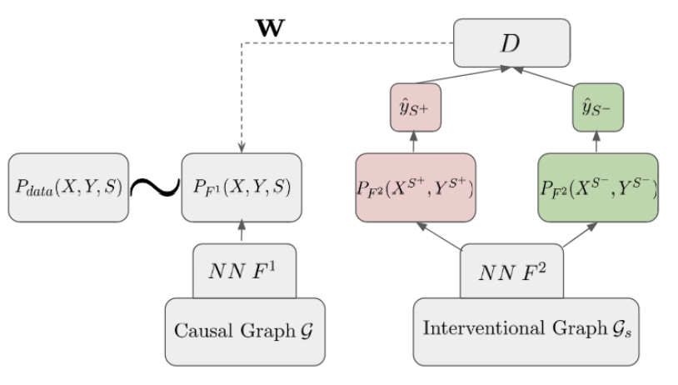
REWEIGHTING APPROACH : Problem Formulation
Objectives:
1) Preserve the goodness-of-fit by maintaining the empirical reweighted data distribution close to the original data distribution for utility of the downstream tasks
2) Ensure that S cannot be used to discriminate when predicting Y based on various causal criteria in the interventional model Ms. We treat S and Y as binary variables in this paper.

Slide 8
Reweighting For Causal Fairness
1) Reweighting for Total Fairness
a) Neural Networks F 1 and F 2
One neural network F 1 simulates the causal model M.
Other neural network F 2 approximates the interventional model according to the causal effect measured.
b) Discriminator : (it makes the generated data seem indistinguishable to original data)
It penalizes the differences between the generated data for different sensitive data.
It ensures that the synthetic data is similar enough to original to mitigate bias.
c) Weights
To formulate an objective function that balances goodness-of-fit and causal fairness.
The strategy involves downweighting and upweighting based on fairness constraints and extends to path-specific fairness considerations.
2) Reweighting for Path-Specific Fairness
3) Reweighting for Counterfactual Fairness

Slide 9
EXPERIMENTAL EVALUATION
Wasserstein Distance: The Wasserstein distance between manipulated data and original data is computed to assess the utility of the downstream tasks. A smaller Wasserstein distance indicates closer distributions and better utility. It is a measure of the effort required to transform one distribution into the other.
Indirect discrimination: refers to a form of discrimination that occurs when a policy, practice, or decision seems neutral on the surface but has a disproportionate and adverse impact on a particular group of people based on certain characteristics, such as race, gender, or other protected attributes.
Counterfactual fairness: aims to evaluate whether the predicted outcomes for an individual would be fair under different hypothetical conditions, specifically when certain attributes are changed.

Slide 10
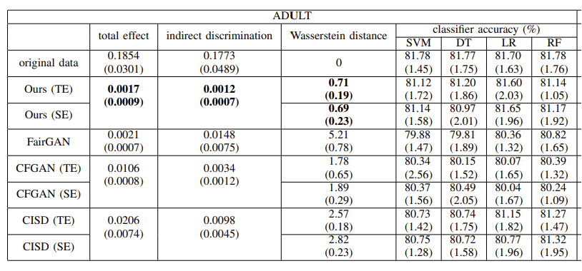
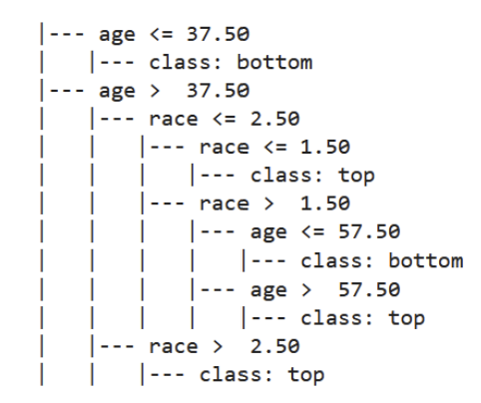
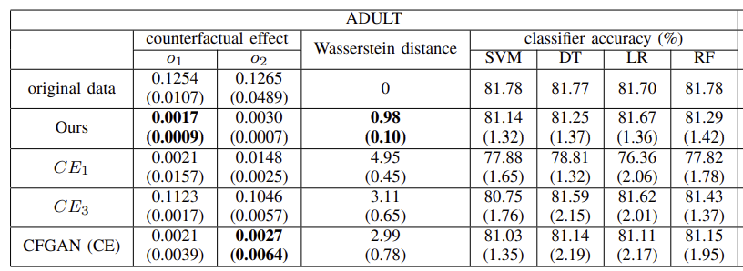
Experimental Results for Adult Dataset
Example of weights and their attributes

Slide 11
CONCLUSION
The overall architecture is trained to balance fairness objectives with minimal loss of utility, and the experiments conducted the datasets demonstrate improvements over existing approaches for the targeted causal fairness notions. The method is versatile, considering various causal fairness objectives, including total fairness, path-specific fairness, and counterfactual fairness.
Explainability: By analyzing the sample weights assigned by the method, users can gain a better understanding of the distribution of biases, helping to interpret and address potential sources of unfairness.

